Slide 1




3
Power BI
QUICK START
Prepared By :
Said Fawzy
Manager of Information Center
Tendering Department
Arab Contractors

Slide 2

Module 3
Data Modelling in Power BI

Slide 3
01
Data Model View
02
Type of Joints
Module Contents
03
Table Relationship
Cross Filtering Direction
04

Slide 4
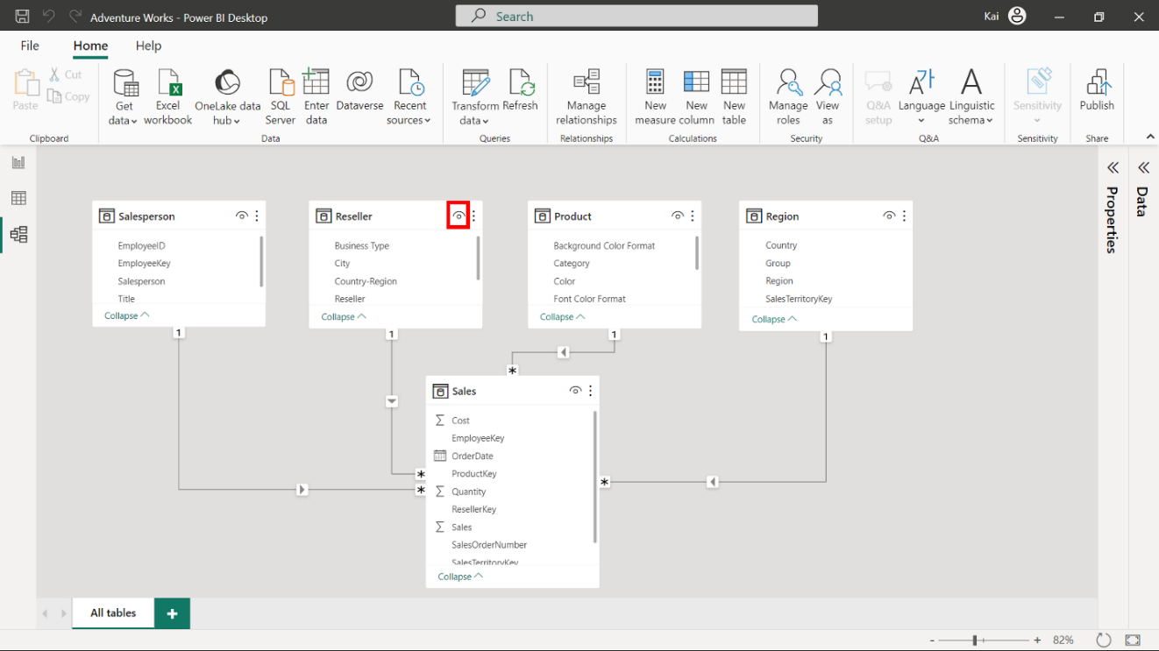
Diagram view (Canvas)
The small eye icon on the top right of the table diagram allows you to hide the table from the Power BI desktop report view

Slide 5

Diagram view (Canvas)
You can access more options by selecting the ellipses beside the eye icon of the table diagram.

Slide 6
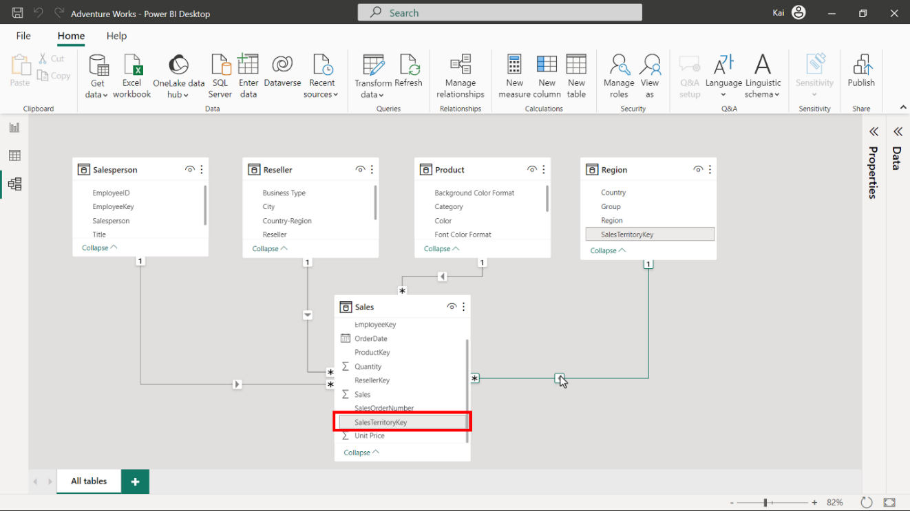
Fields
Fields are columns within your data tables.
In the Model view, these fields are listed under their respective tables.
All calculations (calculated columns and measures) also appear as fields in the data tables.

Slide 7
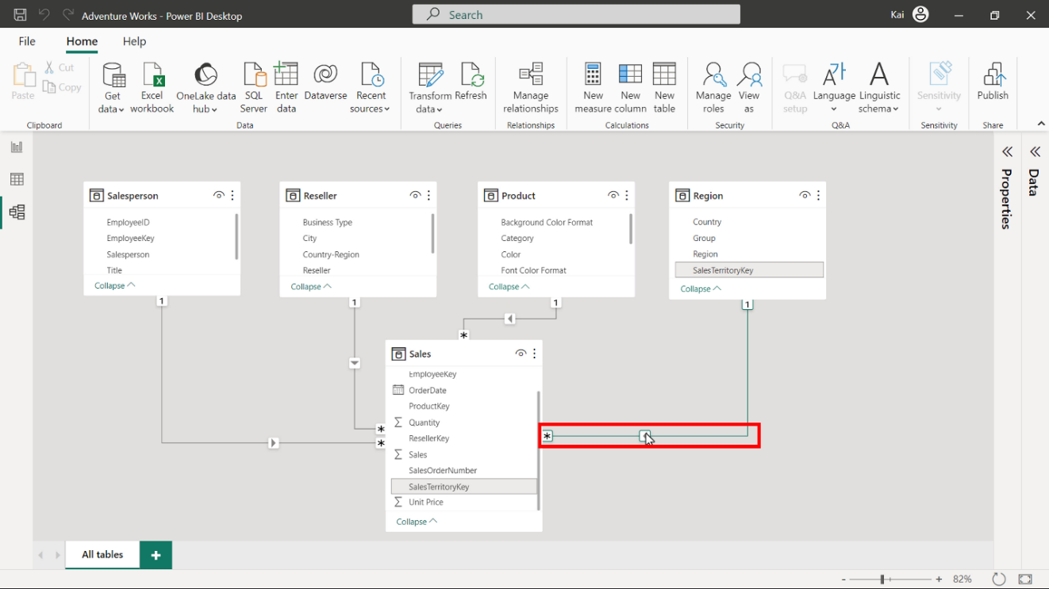
Relationships
Tables are related through a relationship line (connector line).
When you hover over the connector line, it highlights the fields used to establish the relationship.
The arrow on the connector line indicates the direction of the relationship (cross-filter direction).

Slide 8
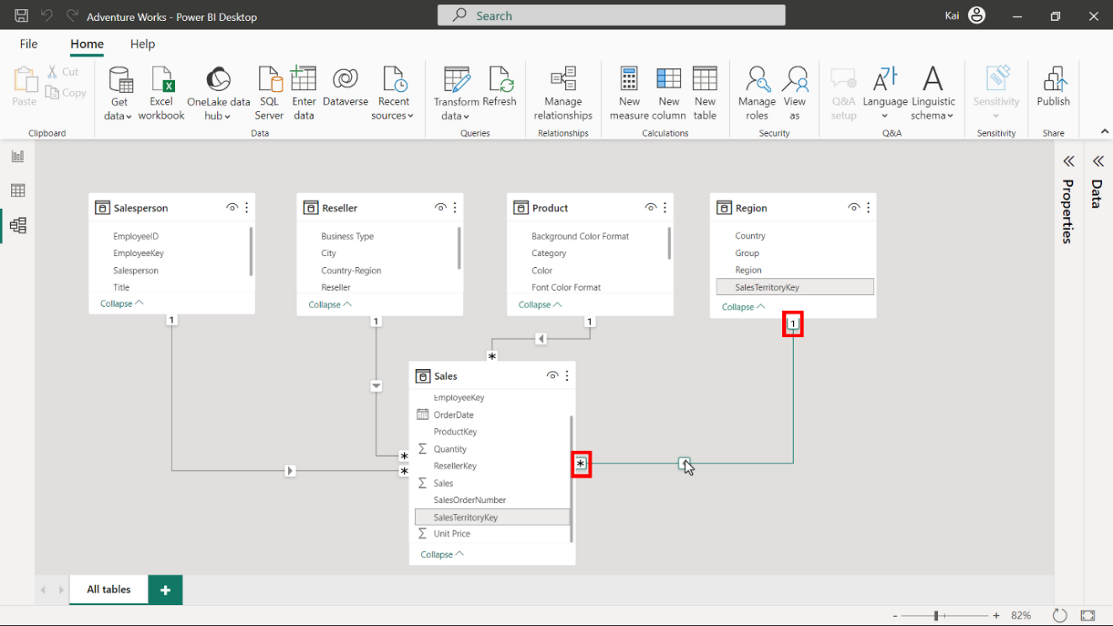
Relationships
The connector line connects two tables.
The 1 icon represents the one side of the relationship, while the * icon indicates the many side of the relationship

Slide 9
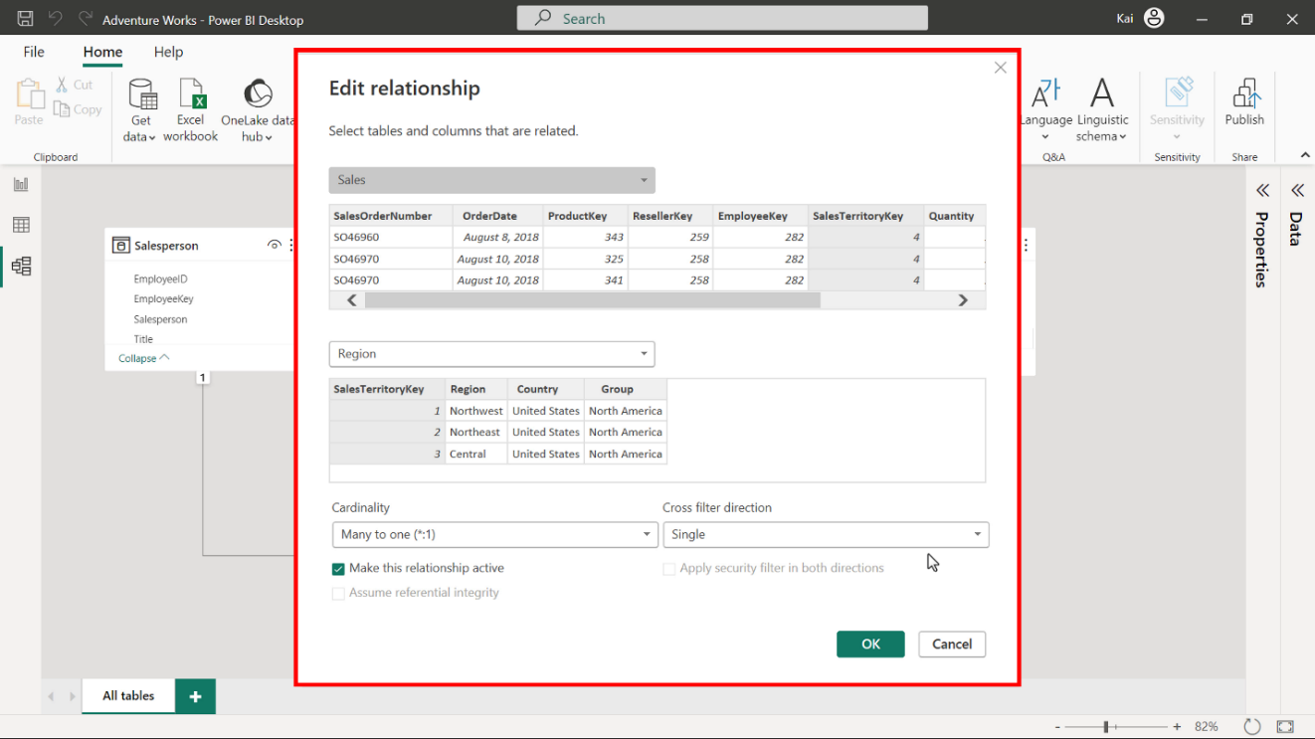
Relationships
You can select and double-click the connector line to open the Edit relationship window.
You can use this window to edit or configure the relationships between your data tables.

Slide 10
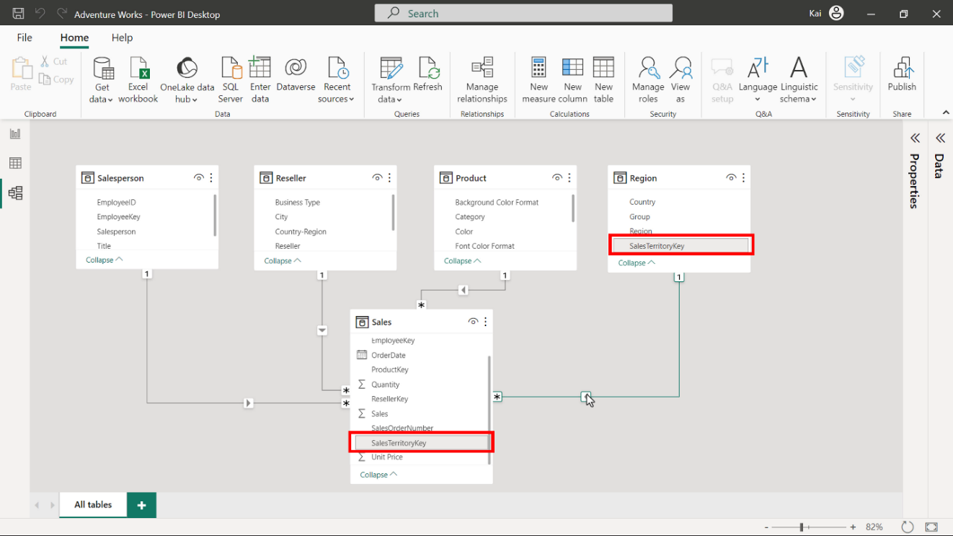
Relationships
When you load multiple tables into your data model, Power BI automatically detects their relationship based on the common key field.

Slide 11
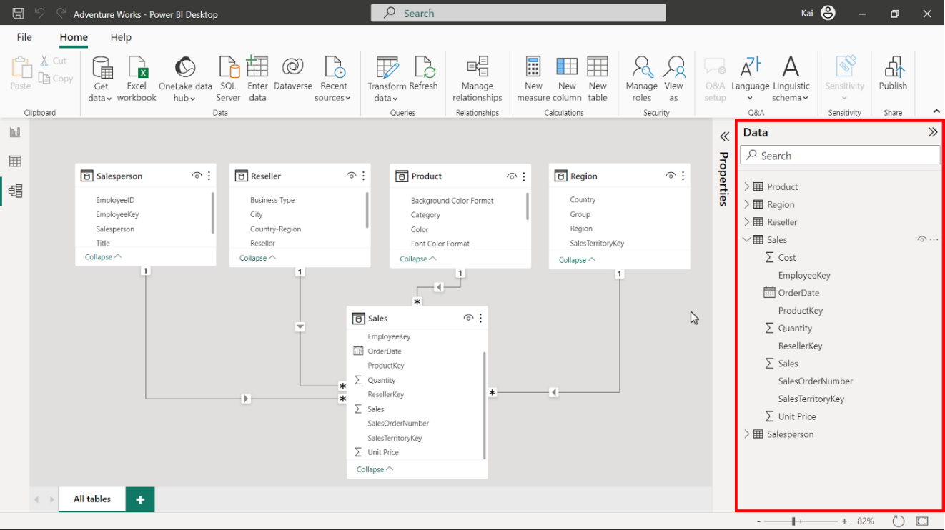
Data Pane
The Data pane is the common element in all three views of Power BI desktop (Report view, Data view, and Model view).
The Data pane lists all data tables and fields within the tables. All types of calculated tables, columns, and measures you will create are listed under the Data pane.
If your data model contains many tables, you can use the search bar to locate a specific data table.

Slide 12
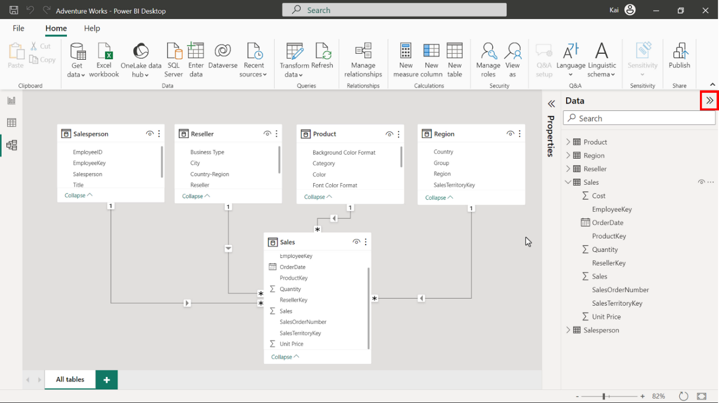
Data Pane
You can also expand or collapse the data pane by selecting the double arrow.

Slide 13
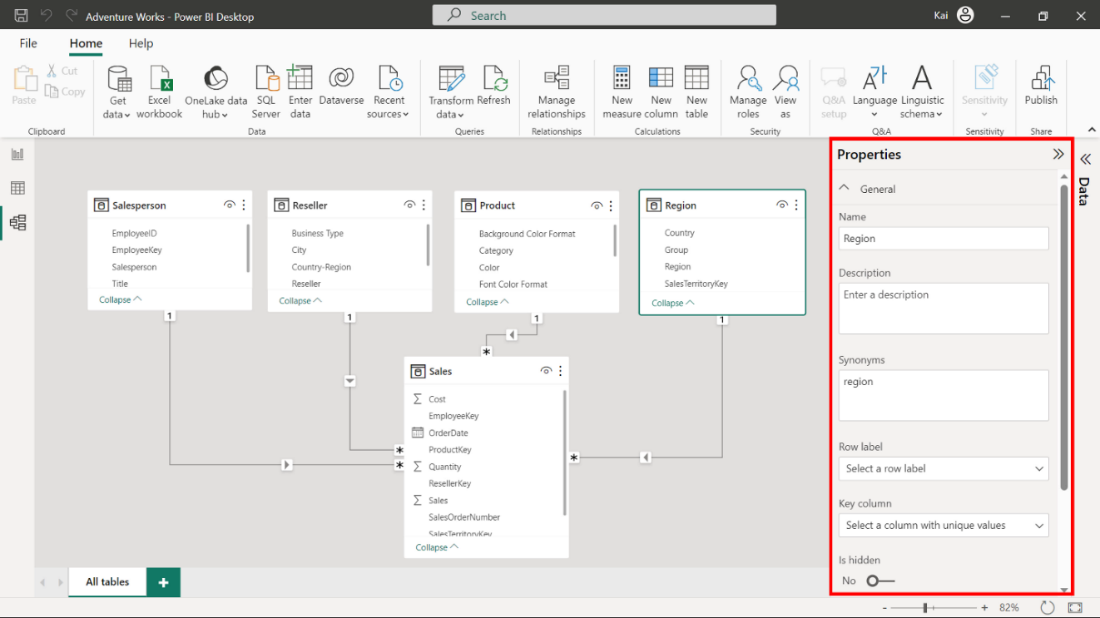
Properties pane
You can use the Properties pane to edit and configure table and column properties within your data model.
The pane has two sets of properties: General and Advanced.
You can use these properties to rename your table and columns, add descriptions, and configure other table and column properties

Slide 14
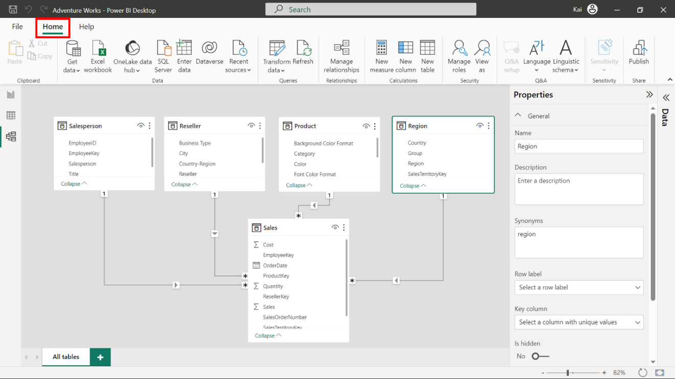
Home ribbon
The Home ribbon of the Model view offers a range of functions to shape and structure your data before preparing it for reports and visualizations.
Below is a list of the various groups of functions available in the Home ribbon.

Slide 15
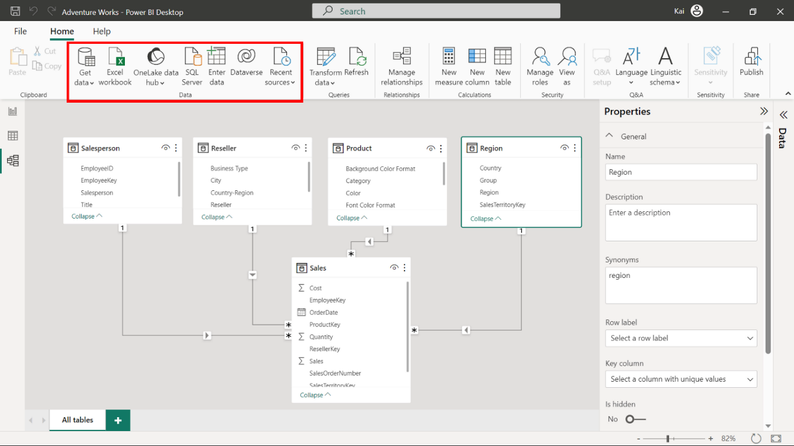
Home ribbon
Feature: Data
Explanation:
The Home tab’s Data group is like the Report view and Data view.
It offers data connectivity options for Power BI.

Slide 16
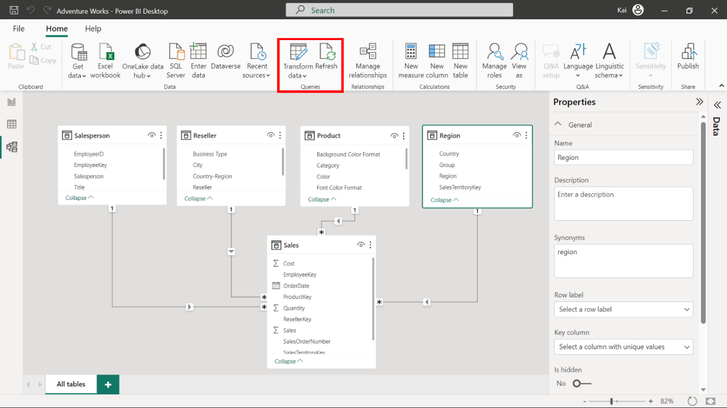
Home ribbon
Feature: Queries
Explanation: This section contains two elements:
Transform data redirects you to the Power Query editor, where you can perform necessary transformations on your data.
Refresh is used for data refresh. This is useful for when you change a dataset.

Slide 17
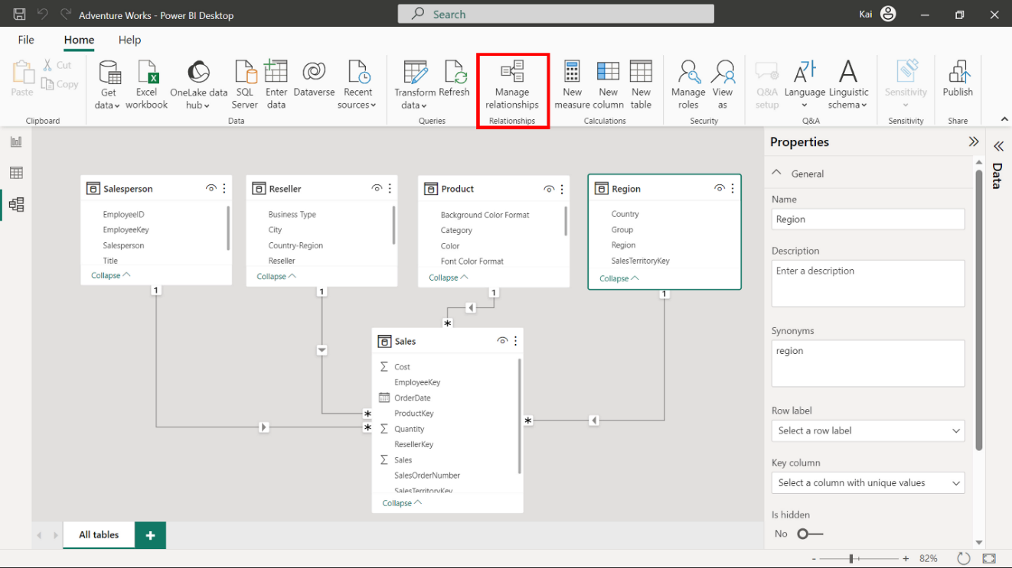
Home ribbon
Feature: Manage Relationships
Explanation: This is the only element in the relationships group that you can use to establish new relationships between data tables and edit existing relationships.

Slide 18
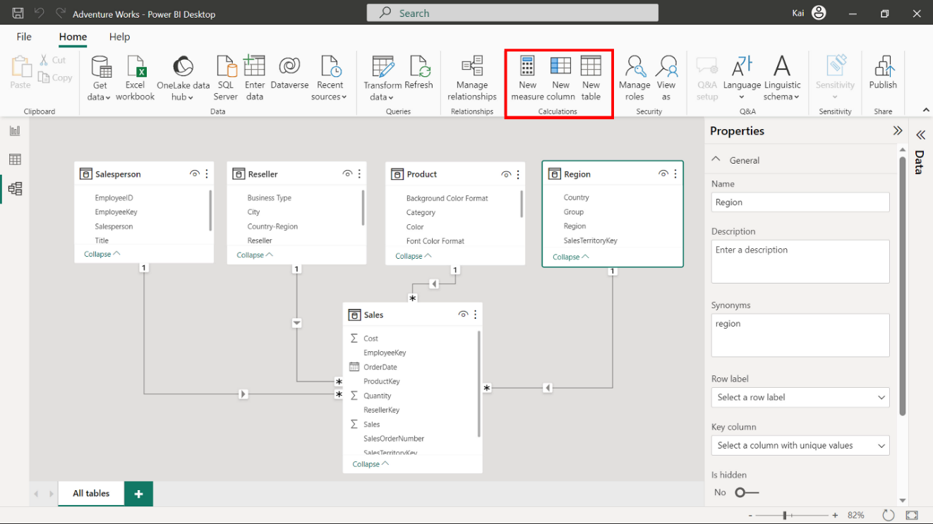
Home ribbon
Feature: Calculations
Explanation: You can use this group to add new custom calculations to your data model, like creating new tables, columns, and measures.
These calculations are created using a Power BI language called Data Analysis Expressions (DAX).
These calculations enable you to enhance your data analytic capabilities and uncover the information hidden in your data.

Slide 19
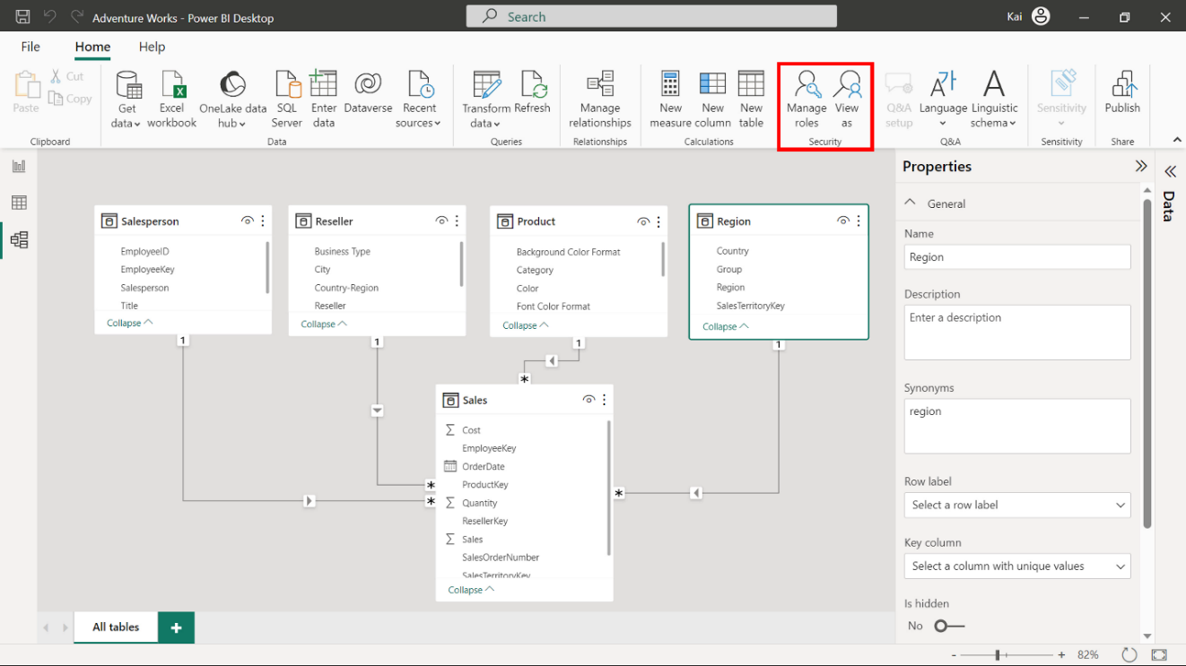
Home ribbon
Feature: Security
Explanation: You can use this feature to define roles and rules within Power BI desktop to restrict data access for certain users.
This provides you with better security for your data.

Slide 20
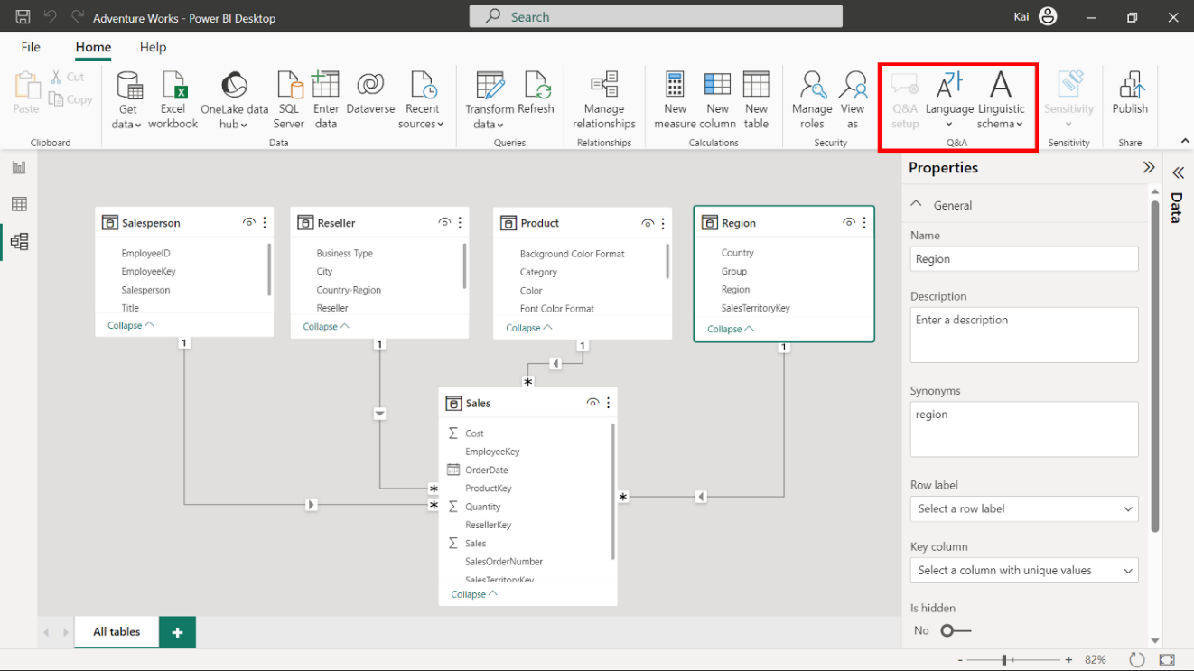
Home ribbon
Feature: Q&A
Explanation: Q&A (Question and Answer) is a powerful natural language query and visualization tool that you can use to interact with data more intuitively.

Slide 21
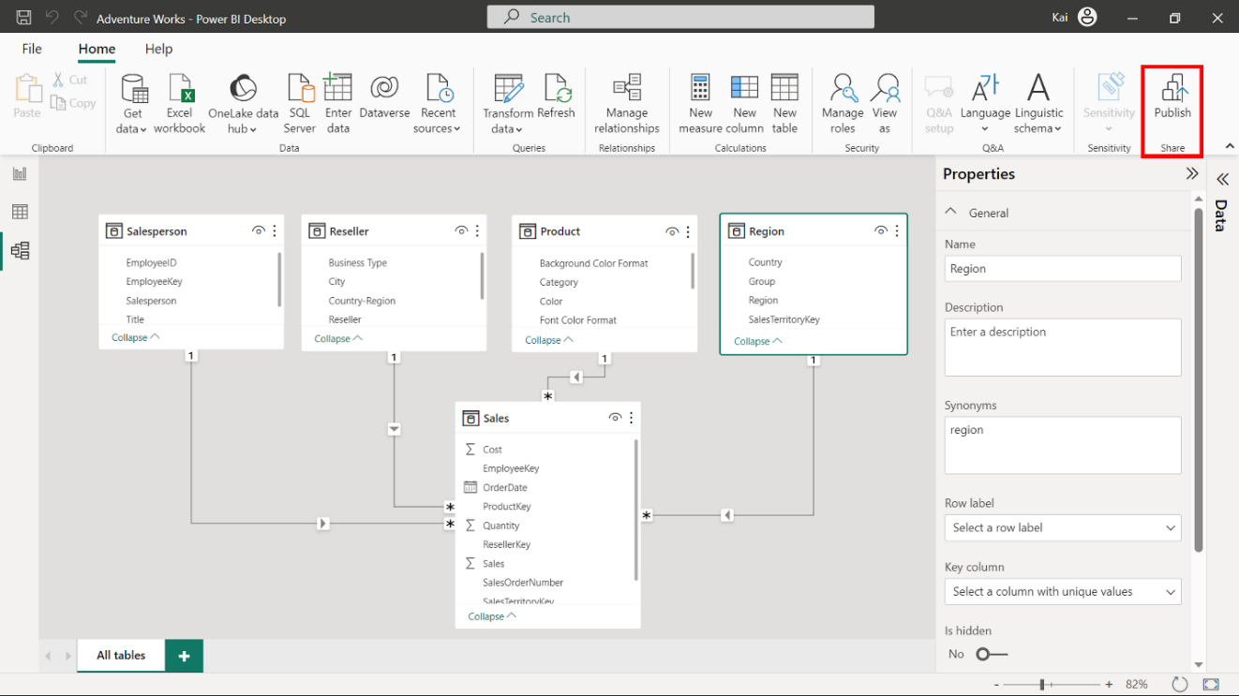
Home ribbon
Feature: Share
Explanation: You can use this element to share your report with other users within your team for effective collaboration

Slide 22
Types of Joints

Slide 23



Slide 24

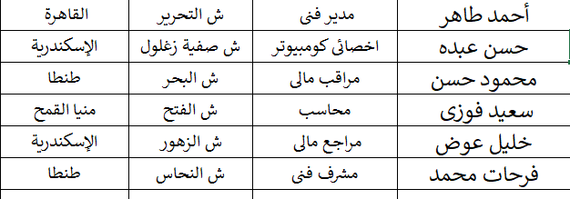
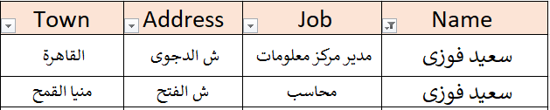
Emp
بيانات سعيد فوزى

Slide 25
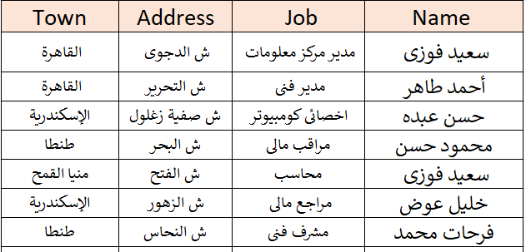
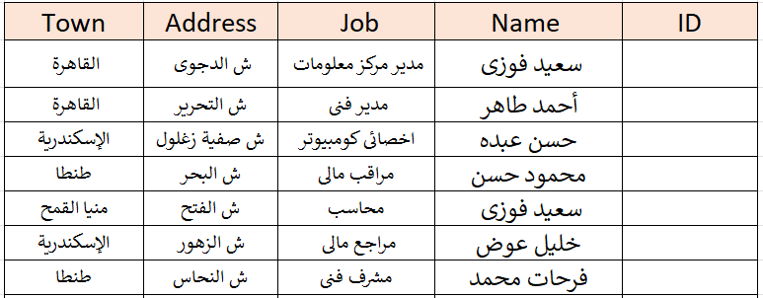
Constraints
Emp
PK
INSERT
Required
UPDATE
Unique

Slide 26

Constraints
Emp
PK
INSERT
Required
UPDATE
Unique

Slide 27
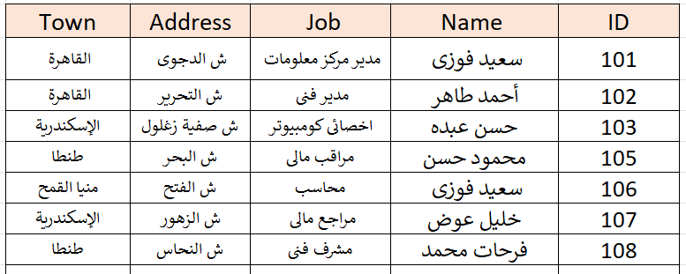
Emp
INSERT

Slide 28

Emp
INSERT

Slide 29
Emp
INSERT

Slide 30
Emp
INSERT

Slide 31
Emp
INSERT

Slide 32
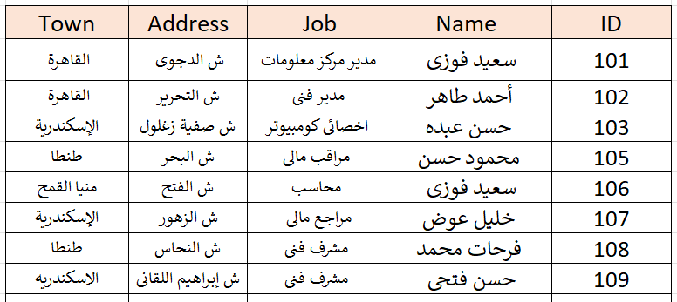



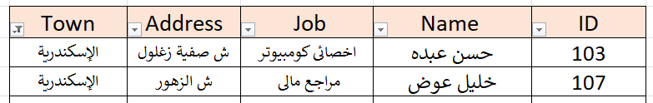
Emp
الإسكندرية

Slide 33
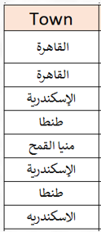
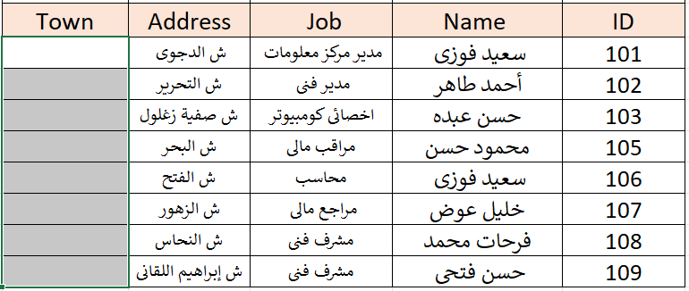
Emp

Slide 34
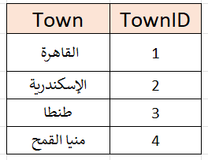
Emp
Towns

Slide 35
Constraints
Emp
Towns
PK
Required
Unique

Slide 36

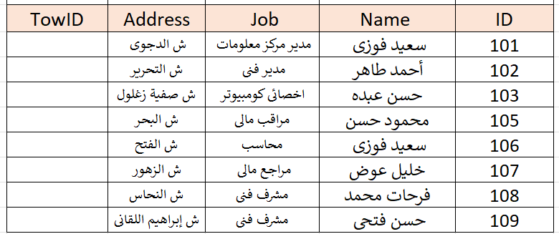
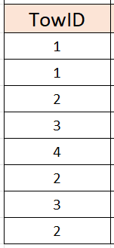
Emp
Towns
FK
PK
INSERT
Constraints
UPDATE
DELETE

Slide 37
Emp
Towns
FK
PK
INSERT
Constraints
UPDATE
DELETE

Slide 38
Emp
Towns

Slide 39
Emp
Towns

Slide 40
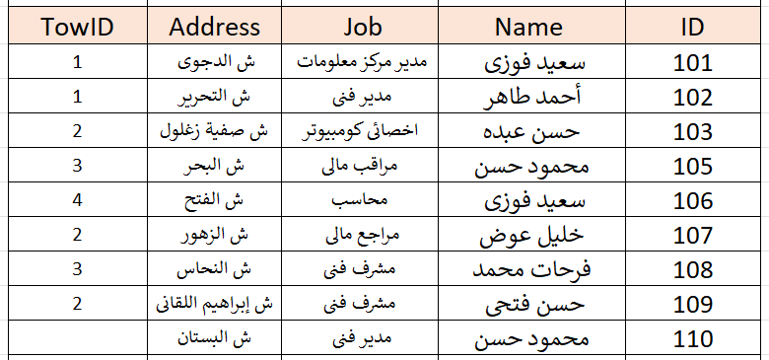
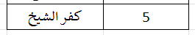
Emp
Towns

Slide 41

Emp
Towns
DELETE
We have no Orphans

Slide 42
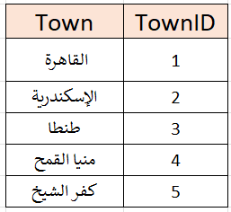
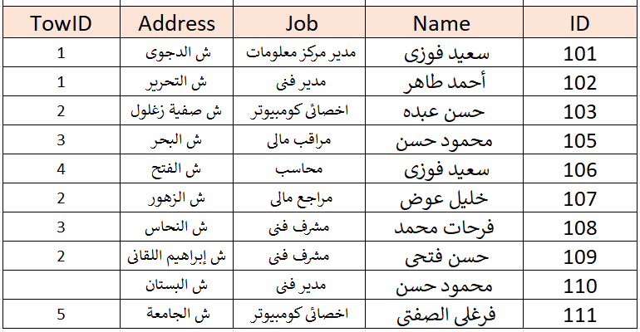

Towns
1
Emp

Slide 43
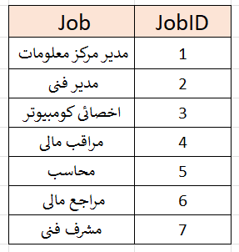
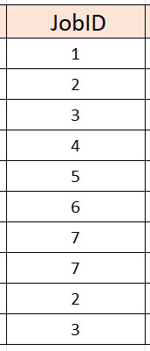
Towns
Jobs
1
1
Emp

Slide 44
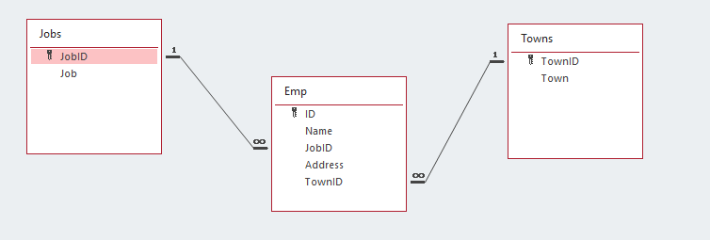

Slide 45
Towns
Jobs
1
1
Emp
How to retrieve data ?

Slide 46
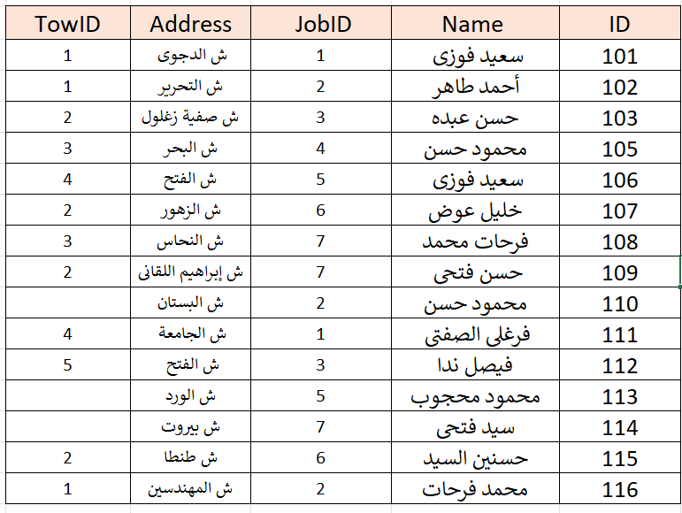

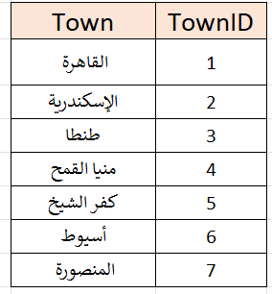
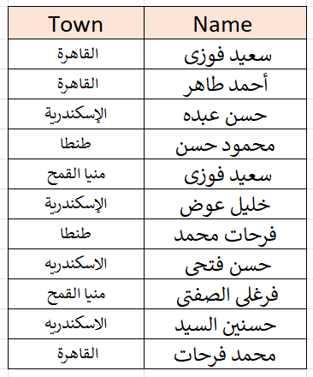
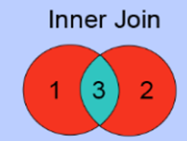
الاسم والبلد
المشترك فقط

Slide 47
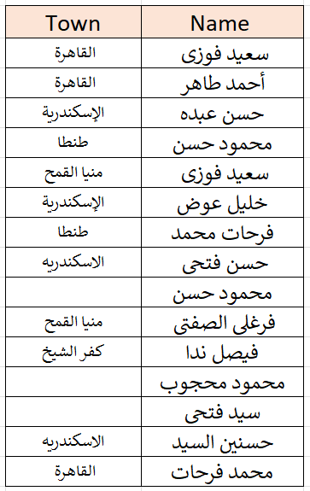
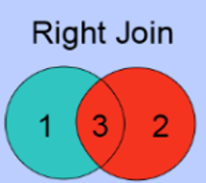
الاسم والبلد
كل الأسماء

Slide 48
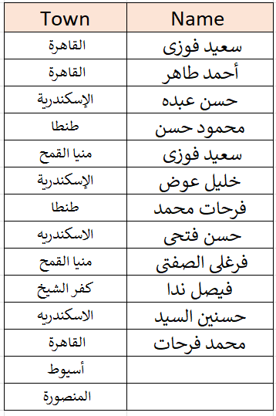
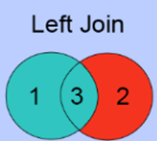
الاسم والبلد
كل البلاد

Slide 49
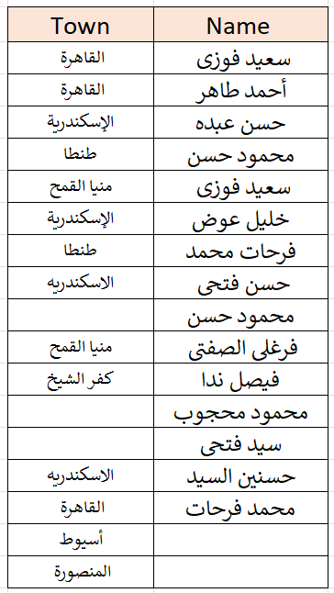
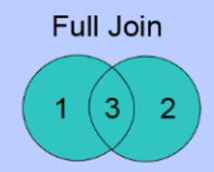
الاسم والبلد
كله كله

Slide 50
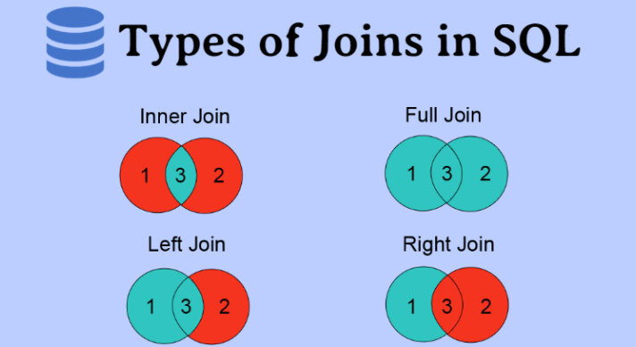


Slide 51
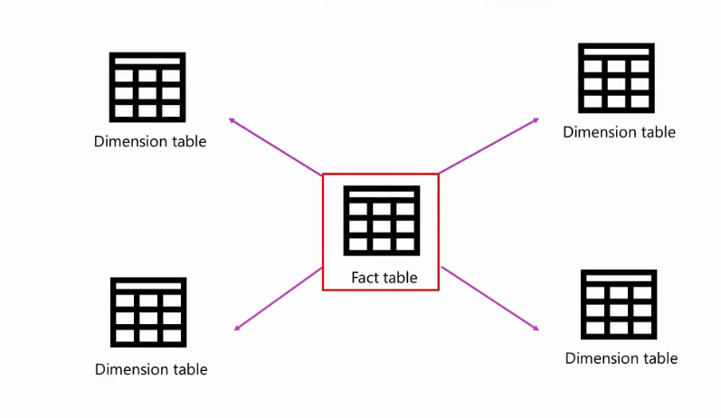
Table Relationship
Fact Tables and Dimension Tables

Slide 52
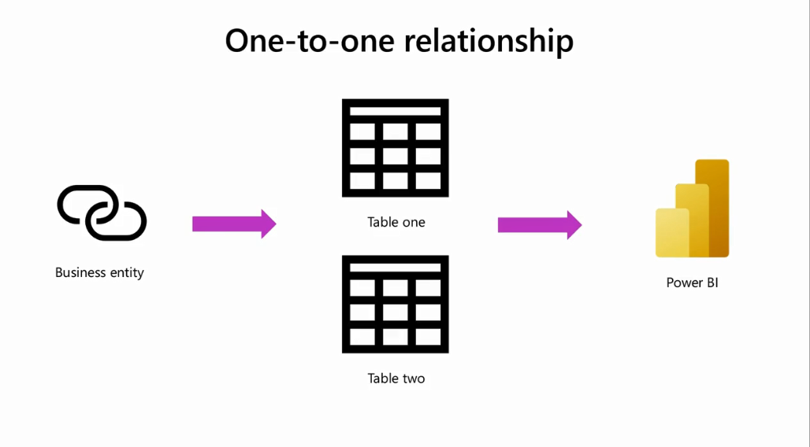
Cardinality

Slide 53
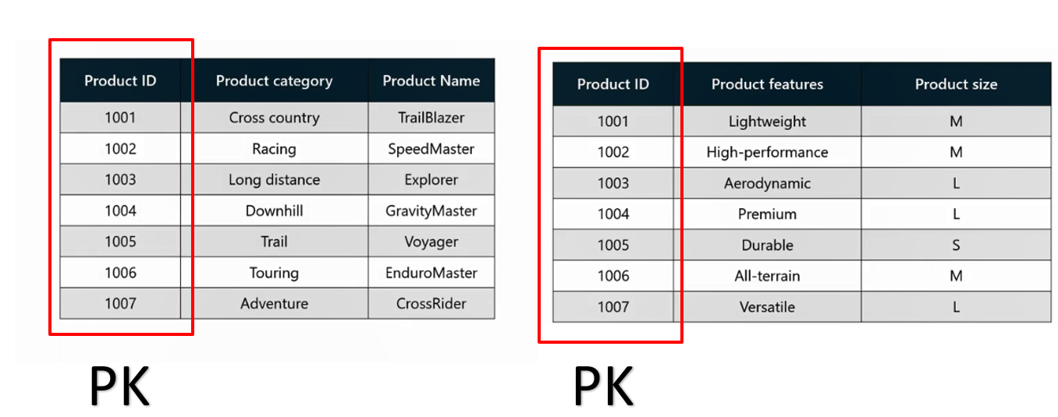
Cardinality

Slide 54

Cardinality

Slide 55

Cardinality

Slide 56

Cardinality

Slide 57

Creating relationships in Power BI
Manually create relationships
Access the Home tab, then select Manage Relationships

Slide 58

Creating relationships in Power BI

Slide 59
Creating relationships in Power BI

Slide 60

Creating relationships in Power BI

Slide 61

Creating relationships in Power BI

Slide 62

Creating relationships in Power BI

Slide 63

Cross-Filtering Direction
Your company needs to calculate which members of its sales team have sold the most product types and should be awarded a bonus.

Slide 64




Cross-Filtering Direction
1-
1-

Slide 65

Cross-Filtering Direction

Slide 66


Cross-Filtering Direction

Slide 67

Cross-Filtering Direction

Slide 68




Cross-Filtering Direction

Slide 69

Cross-Filtering Direction

Slide 70


Exercise 5
Configuring Relationship
Between Tables

Slide 71



